Slide 1
Student Organization Registration
Student Organization Resource Center

Slide 2
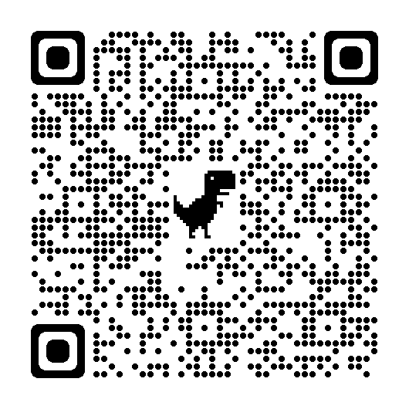
Slide Deck

Slide 3
Who am I?
Notes:
Presenter Introductions:
Name:
Pronouns
Position in SORC
Year
Major
Campus Involvement

Slide 4
What’s Our Why?
The Student Organization Resource Center (SORC) is committed to supporting student success through involvement and leadership opportunities.
SORC is the source for your student involvement needs and desires, from finding a student organization to join, to registering a new student organization and providing assistance and support to existing student organizations.
Notes:
At this point you can also introduce the “WHY” of SORC

Slide 5
What is student organization registration?
Who Runs It?: Student Organization Resource Center
How Often Does It Happen?: Annually (Fall & Spring)
When Does It Happen Next?:
Now - Thursday, December 7th, 2023 | Closes at 11:45pm EST | *No Exceptions Made
Where Does It Happen?: On Terplink (Student Org. Database)
Registration Guide Page: 3

Slide 6
What are the benefits?
Access to:
TerpLink Portal
Venue Space
Stamp, and SIS
Marketing Resources
Printing Funds, Digital Signs, Newsletter, Social Media, and Bulletin Boards
Apply for a Storage Locker
Recruitment Opportunities
First and Second Look Fair
Funding Opportunities
SGA, GSG, Pepsi Grant, and More
Registration Guide Page: 3

Slide 7
What Resources Can I Use To Succeed?
Registration Checklist: Registration and renewal for new and returning student organizations are done through TerpLink. To help with this process SORC has designed a checklist for each unique organization registration. These checklists will provide step-by-step instructions to take pre registration, during registration, and post registration submission.
Registration Guide: This is a reference guide for student organization leadership, faculty/staff advisors, and campus partners. It is not meant to be read cover to cover. We wrote it to advise and guide you on whichever challenge, or question you are facing right now with the registration process.
Any page numbers references in this presentation will give you further details on the topic in the registration guide.
Registration Guide Page: 8

Slide 8
What Resources Can They Use To Succeed?
Registration Help Drop-In Hours:
Thursday, November 9th, 2023 | 5 PM
Wednesday, November 15th, 2023 | 6 PM
Registration Guide Page: 6

Slide 9
Has Anything Changed? Yes!
Officer training has moved to ELMs
How do they get access? | Page 15
What does it look like? | Page 22
New Resource Library
Registration Guide Page: 15

Slide 10
What should I prepare before registering? | Pre-Registration Checklist
Roster
Officer Training
Advisor Agreement
Constitution
Registration Guide Page: 9

Slide 11
How do I submit my re-registration? | Registration Submission Checklist
Step 1: Search TerpLink (terplink.umd.edu)
Step 2: Click “Sign In”
Step 3: Sign in with your UMD credentials
Step 4: Authentication
Step 5: Click “hamburger button”
Step 6: Click on the gear icon
Step 7: Select manage home
Step 8: Click “Re-Register” (*Only Pres. or Treasurer)
Step 9: Follow the steps in the registration process/form
Registration Guide Page: 9

Slide 12
What do I do after I submit? | Post-Registration Checklist
Confirmation Email: Confirm that you got a confirmation email for your registration submission
Check Back Daily: Check back daily using the registration tracking sheet to see if your submission has been denied or approved
Reach Approval: Your goal is to reach approval before Thursday, December 7th, 2023, so don’t wait
Registration Guide Page: 9

Slide 13
What does the data tell us?
Most Common Registration Requirement Errors (Spring 2023 Data)
Advisor Agreement 40% | Roster Requirements 15% | Officer Trainings 30% | Constitution Requirements 8%
Avg. Number of Submissions Per Org 3X
Avg. Length Of Time From Submission To Get Reviewed 1 Day
Registration Guide Page: 14

Slide 14
What are my orgs first steps after this presentation?
Set Reminders: Set yourself multiple reminders to complete your registration before Thursday, December 7th, 2023
Download Your Checklist: Download a copy of the registration checklist and guide for
your organization to use
Complete The Pre-Registration Checklist: Before jumping into TerpLink to start your registration, make sure you completed every item in your pre-registration checklist
Submit Your Registration: Get your registration in early, so SORC can help you if you have any errors and get denied
Reach Approval: Your goal is to reach approval before Thursday, December 7th, 2023, so don’t wait
Don’t Wait, Get It Done Now!

Slide 15
Registration Is Due Soon:
Thursday, December 7th, 2023 | By 11:45 PM EST
Your goal is to reach approval before Thursday, December 7th, 2023, so don’t wait

Slide 16
Contact Us
The Student Organization Resource Center (SORC) is located in the Student Involvement Suite, on the ground floor of the Stamp Student Union.
Website: stamp.umd.edu/sorc
Email: sorc@umd.edu
Phone: 301-314-7158
Hours of Operations
Monday - Friday: 9:00 AM - 10:00 PM
Saturday & Sunday: 12:00 PM - 6:00 PM
@marylandsorc on Twitter and Instagram
Maryland SORC on Facebook

Slide 17
Slide Deck

Slide 18
Questions

